Slide 1

KNEE OSTEOARTHRITIS PREDICTION AND SEVERITY Submitted in partial fulfillment of the requirements for the award of degree of
BACHELOR OF TECHNOLOGY
IN
INFORMATION TECHNOLOGY
Under the supervision of:
Mr. Jaswinder Singh Dhillon
Assistant Professor (IT)
Submitted By: Akhil Katyal [1903815]
Anmol Sehdev [1903819]
Ishita Seth [1903835]
DEPARTMENT OF INFORMATION TECHNOLOGY
DAV INSTITUTE OF ENGINEERING & TECHNOLOGY
Jalandhar - 144008

Slide 2
Table of Contents
Introduction
Existing system study/Literature Review
Objectives
Requirement Analysis
System Design/Architecture
Implementation & Testing
Results & Discussion
Conclusions & Future Scope
References

Slide 3
INTRODUCTION
What exactly is deep learning?
Deep learning is a machine learning technique that teaches computers to do what comes naturally to humans: learn by example. Deep learning is a key technology behind driverless cars, enabling them to recognize a stop sign, or to distinguish a pedestrian from a lamppost.
What is CNN algorithm?
In deep learning , a convolutional neural network (CNN) is a class of deep neural network, most commonly applied to analyze visual imagery. Now when we think of a neural network we think about matrix multiplications but here it uses a special technique called Convolution. Now in mathematics convolution is a mathematical operation on two functions that produces a third function that expresses how the shape of one is modified by the other.

Slide 4
INTRODUCTION OF THE PROJECT
Osteoarthritis is one of the most prevalent degenerative musculoskeletal diseases. This disease is a leading cause of disability among elderly adults , which affects 30 % of the global population over the age of 60 years old[1]. with more than 250 million patients worldwide, 1-2% of the gross domestic product is spent on OA[2][3]. With the ageing of global population, the number of patients who suffer knee osteoarthritis (KNO) is expected to increase[4] . Knee OA is a condition driven by mechanical wear and tear as well as biochemical changes .Known risk factors for OA include aging, obesity and previous Knee injuries . OA causes pain that limits function and reduces one’s quality of life . The joint damage of OA is irreversible , and definitive treatment requires total knee replacement (TKR) , which is expensive and has a short life span especially for the obese individuals . Therefore, early detection of knee OA is crutial for initiation of therapy such as weight reduction and exercises that has been found to be effective in halting knee OA progression and delaying.

Slide 5
Current radiographic grading scales form OA rely primarily on Kellgren-Lawrence grading which examines the changes shown on X- Ray plain radiography images. However, this approach causes delay in OA diagnosis because the bony changes only appear in advanced conditions. Besides, X-Ray , other imaging modalities such as magnetic resonance imaging can utilize several OA soft tissue biomarkers such as cartilage and meniscus degeneration and also deformation of the subchondral and trabecular bone to determine the onset of knee OA . There exists different types of OA-related segmentation or classification models for assessing the knee which are generally classified into classical methods and deep learning (DL) methods . In current clinical practices , evaluation of OA severity is normally performed visually with radiography images , which prone to interrater variability and time consumption for large datasets .

Slide 6
So we aim to design an automatic diagnosis system which can decrease the time- consumption and to reduce the uncertainties due to human error. Deep learning is an effective technique for the analysis and classification of images, which is widely applied in various fields such as the medical field, and demonstrates excellent performances.

Slide 7
Background Study
Fuzzy c means algorithm:
The fuzzy c means algorithm has been used for thermal image segmentation. The fuzzy c means algorithm is a technique for image segmentation and pattern recognition [5]. Fuzzy c means algorithm is a combination of fuzzy algorithm and clustering. In this segmentation method the region of interest was segmented based on the clusters present in the object. Image segmentation is carried out in Matlab platform.

Slide 8
The step by step procedure of this algorithm is summarised below.
Step 1: Compute the Initial matrix
Step 2: Choose the number of clusters
Step 3: Identify the centre points for cluster
Step 4: Find the mean values of the cluster data points and create the object.
The thermal image from the patients and control subjects was in the .jpeg format. Initially the image was read in the MATLAB software. The loaded image in MATLAB was in the RGB (Red Green Blue) image. The image was converted to grey image. Then the initial matrix was computed. After that the number of clusters in each matrix was chosen. From the chosen cluster the centre point of cluster was identified. Mean of the data points in the cluster was calculated. Using this values a new object was created in the blank image. That new image is the segmented output

Slide 9
DRAWBACKS OF EXISTING SYSTEM
This system is complex and unable to recover from database corruption.
This model required much more computational time.
This model is not good for noisy images.

Slide 10
PROBLEM FORMULATION
The problems in the previous model on which we are going to work are listed below:
➢ Low accuracy of diagnosing the severity of problem
➢ Time consumption
➢ Not user friendly

Slide 11
OBJECTIVES
To carry out the current work, objectives were identified, and they are outlined as follows.
➢ To evaluate the contributions of radiographic knee osteoarthritis (KOA) and knee pain severity
➢ To collect & analyze relevant datasets :
* mild dataset * doubtful dataset * normal dataset * severe dataset * moderate dataset
and use them to predict the signs of KOA.
➢ To develop a system that can reduce time -consumption & to reduce the uncertainties due to human error.
➢ To improve the accuracy of diagnosing the severity of KOA using CNN model

Slide 12
Requirement Analysis
Hardware Requirements:
Processor –Core i3 or above
Windows 7 or higher
Hard Disk – 160 GB or higher
Memory – 1GB RAM or higher
Software Requirements:
Python
Django framework
Visual Studio code
MySQL database

Slide 13
SYSTEM DESIGN/ARCHITECTURE
The patient has the option to register and fill his details. He has to give his name, username, x-ray photo, guardian photo, his own photo, identity photo, licence photo and other details. We can have people of same names but we cannot have people with similar username. And hence there will be no mis-match. Each person will have a unique username and a particular detection along with its symptoms and solution.
We first train the datasets. We have 5 classes of images and after training by CNN algorithm used in this project, we have different convolutional layers forming on it and after each layer, the precision keeps increases. How many layers being used depends upon the number of eposch used. More the number of eposch, more the precision. After a .h5 file is created which contains all the attributes and confidence score for each detection class.
once the x-ray photo has been uploaded, the photo undergoes resizing and colour change to grey and thenthere several convolutional layers applied on it by the help of CNN algorithm used in this project and a confidence score is generated and is matched with the confidence score in the .h5 file and the class is detected and hence detection is done

Slide 14
The system comprises of 2 major modules with their sub-modules as follows:
Admin:
Login-Admin can login into the system using username and password.
View Patient -Admin can view patient details.
Logout – Admin can logout from the system.
Patient:
Login – Patient can login into system using username and password.
Register-Patient can register itself in the system to predict the disease.
Logout - Patient can logout from the system.
PATIENT
ADMIN
LOGIN
VIEW
LOGOUT
LOGIN
REGISTER

Slide 15
In system design, we can learn the methodology as :
Pre-Processing: The aim of preprocessing images is to prepare the data for further processing in the proposed system.
Region of Interest (ROI) and Segmentation: The region of interest (ROI) is the tibiofemoral joint.
Deep Learning: Deep Learning performs nonlinear transformation hierarchy-wise. Convolution Neural Network (CNN) has deep architecture which can be applied. Each layer in CNN can see the features and show high variance [6].
Convolution Neural Network as Feature Descriptor: Deep Neural Network layers used for the proposed technique as feature descriptor.
Histogram of Oriented Gradient: The images are converted into sizes from 28×28 to 6×6 concurring blocks, and each block has a 2 × 2 size with a stride of size 4. A total of 1296 low-level features are computed. Normalization can be performed for better feature extraction as pulmonary images show better shadow normalization.
Classification: For the classification, Support Vector Machine is a supervised learning algorithm trained with four classes according to the KL grading system.

Slide 16
Implementation & Testing
HOME PAGE: It provides basic idea about the application and it shows various options and choices from which we can choose according to the work we need to do.
MENU BAR: Menu bar is very useful in containing options/choices which contains sub choices. It is easy to access as it will not disappear as long as frame is not disclosed. In this application the menu bar contains various menu choices i.e. enter login,register.log out. Some of these menus contains there own sub menus(menu items).
i.e. enter/fill a form/enquiry form.
Login sign in/register→→ register
log out →→ exit
ENQUIRY BAR: An enquirer is always not a registrar. Whenever any customer or a enquirer comes his temporary details should be saved for further use to give him updates regarding his knee conditions.
FEEDBACK FORM: A feedback form has been designed to take the reviews from the users for the betterment of the software.

Slide 17
5. REGISTRATION FORM: Generally after opening the website, the user has to register his/herself. 6. LOGIN: After registering once, the user just has to login further to operate the software.

Slide 18
Testing
What is Testing?
Testing is the process of evaluating a system or its components) with the intent to find whether it satisfies the specified requirements or not. In simple words, testing is executing a system in order to identify any gaps, errors, or missing requirements contrary to the actual requirements.
According to ANSI/IEEE 1059 standard, Testing can be defined as - A process of analyzing a software item to detect the differences between existing and required conditions (that is defects/errors/bugs) and to evaluate the features of the software item.
Who does Testing?
It depends on the process and the associated stakeholders of the projects). In the IT industry, large companies have a team with responsibilities to evaluate the developed software in the context of the given requirements. Moreover, developed software in the context of the given requirements. Moreover, developers also conduct testing which is called Unit Testing. In most cases, the following professionals are involved in testing a system within their respective capacities:

Slide 19
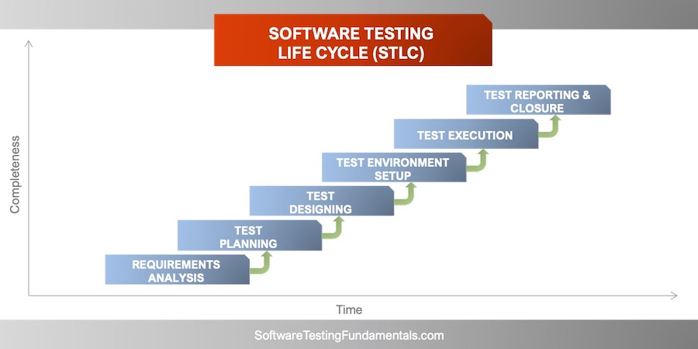
Software Tester
Software Developer
Project Lead Manager
End User

Slide 20
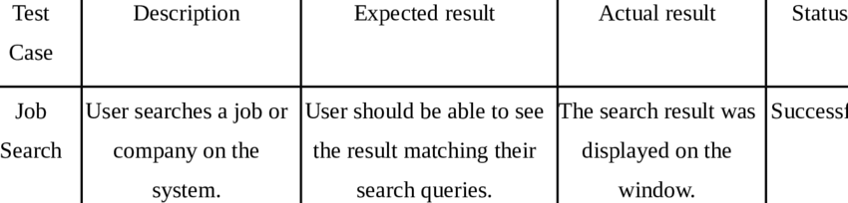
TESTING PERFORMED
Integration Testing : Integration testing is the phase in software testing in which individual software modules are combined and tested as a group. It occurs after unit testing and before Validation testing. Integration testing takes as its input modules that have been unit tested, groups them in larger aggregates, applies tests defined in an integration test plan to those aggregates, and delivers as its output the integrated system ready for system testing.

Slide 21
System Testing : System testing of software or hardware is testing conducted on the complete, integrated system to evaluate the system's compliance with its specified requirements. System testing falls within the scope of black box testing, and as such, should require no knowledge of the inner design of the code or logic. As a rule, system testing takes, as its input, all of the "integrated" software components that have passed integration testing and also the software system itself integrated with any applicable hardware system(s). The purpose of integration testing is to detect any inconsistencies between the software units that are integrated together (called assemblages) or between any of the assemblages and the hardware. System testing is a more limited type of testing; it seeks to detect defects both within the "inter-assemblages" and also within the system as a whole.

Slide 22
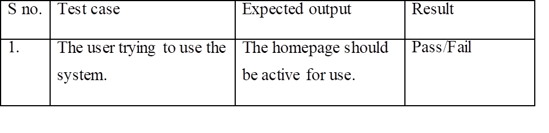
User Acceptance Testing :
User acceptance is a type of testing performed by the Client to certify the system with respect to the requirements that were agreed upon. This testing happens in the final phase of testing before moving the software application to the Market or Production environment. The main purpose of this testing is to validate the end-to-end business flow. It does not focus on the cosmetic errors, Spelling mistakes of System testing. This testing is carried out in a separate testing environment with a production-like data setup. It is a kind of black box. resting where two or more end users will be involved.

Slide 23
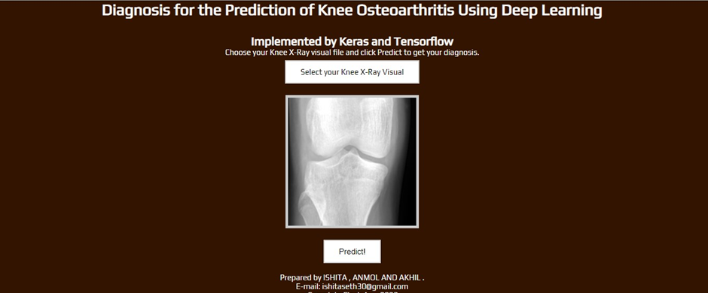
Results & Discussion
In the resulting process, the parameters used for comparisons are:
Mean Square Error
Peak to signal ratio

Slide 24
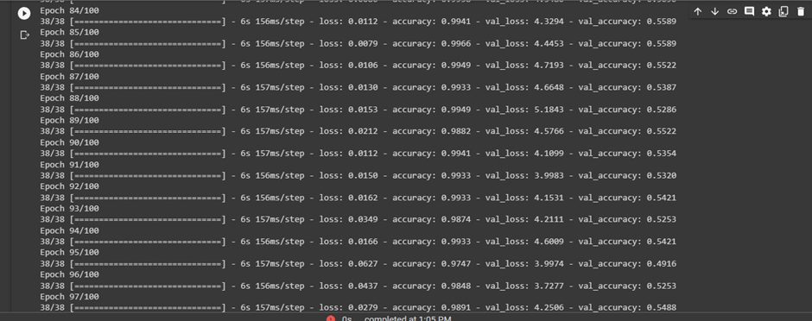

Slide 25
CONCLUSIONS & FUTURE SCOPE CONCLUSION
By using our research we can create and incorporate appropriate programs and commodities to encourage people to find their problems as early as possible.
The main objective of this project was to build a program that helps patients to know how severe his / her knee condition is The system developed is able to meet all the basic requirements. The management of the records will be also benefited from the proposed system, as it will automate the whole procedure, which will help the patient to find their problems as early as possible. The security of the system is also one of the prime concerns.
There is always room for improvement in any software, however efficient the system may be. The important thing is that the system should be flexible enough for future modifications. The system has been factored into different modules to make the system adapt to further changes. Every effort has been made to cover all user requirements and make it user-friendly.
Goal Achieved: The System is able to provide the interface to the owner so that he can replicate his desired data.

Slide 26
User-friendliness: Though most part of the system is supposed to act in the background, efforts have been made to make the foreground interaction with the user(owner) as smooth as possible. Also the integration of the existing system with the project has been kept in mind throughout the development phase. FUTURE SCOPE
The Future Scope of this "KNEE OSTEOARTHRITIS PROJECT is quiteflexible for various other platforms. Directly getting the data for the registered customers. This is quite an easy and accessible approach. This desktop application is a more efficient way of getting results from the patient by sitting at home. This initiative of creating awareness about this makes a healthy lifestyle for everyone.
This type of application can be further used but organized or built with different software, which can remove a slight dependency on manual work.

Slide 27
References
[1] D. T. Felson, A. Naimark, J. Anderson, L. Kazis, W. Castelli, and R. F. Meenan, ‘‘The prevalence of knee osteoarthritis in the elderly. The framingham osteoarthritis study,’’ Arthritis Rheumatism, vol. 30, no. 8, pp. 914–918, Aug. 1987, doi: 10.1002/art.1780300811.
[2] T. Vos et al., ‘‘Global, regional, and national incidence, prevalence, and years lived with disability for 301 acute and chronic diseases and injuries in 188 countries, 1990–2013: A systematic analysis for the Global Burden of Disease Study 2013,’’ Lancet, vol. 386, no. 9995, pp. 743–800, 2015, doi: 10.1016/S0140-6736(15)60692-4.
[3] L. Murphy and C. G. Helmick, ‘‘The impact of osteoarthritis in the United States: A population-health perspective,’’ Amer. J. Nursing, vol. 112, no. 3, pp. S13–S19, 2012.
[4] S. Kurtz, K. Ong, E. Lau, F. Mowat, and M. Halpern, ‘‘Projections of primary and revision hip and knee arthroplasty in the United States from 2005 to 2030,’’ J. Bone Joint Surg., vol. 89, no. 4, pp. 780–785, Apr. 2007, doi: 10.2106/JBJS.F.00222
[5] Lu, Yinghua & Ma, Tinghuai & Yin, Changhong & Xie, Xiaoyu & Tian, Wei & Zhong, ShuiMing. (2013). Implementation of the Fuzzy C-Means Clustering Algorithm in Meteorological Data. International Journal of Database Theory and Application. 6. 1-18. 10.14257/ijdta.2013.6.6.01.

Slide 28
THANKYOU

